Slide 1


Group 5 Presentation
26 May, 2026
Design and Implementation of a Mobile App for Collection of User Experience Data from Mobile Network Subscribers
System Modeling & Design
Mugha Brayan
Ako Mc Peace
Anelka
Lucy

Slide 2

Personal Presentation
Overview
introduction
Mobile network quality varies significantly across regions and times, creating inconsistent user experiences that often go unreported. Traditional monitoring methods fail to capture the real-world perspective of subscribers.
Getting user experience data offers a powerful solution, enabling telecom providers and researchers to gather authentic feedback directly from network users at scale.
Our goal is to develop a comprehensive mobile app system that collects, synchronizes, and analyzes user experience data from mobile network subscribers.
Mobile Users
Telecome Companies
Better Experience

Slide 3

Key focus areas
09 May, 2026
Project Objectives
The system is designed to address critical gaps in mobile network quality monitoring through a comprehensive data collection and analysis platform. By combining automated metrics gathering with user feedback mechanisms, the platform enables telecom providers and researchers to gain actionable insights into network performance across different regions and conditions.
Collect Passive Network Metrics
Reliability
On |Offline Detection
Visualizations

Slide 4

System Architecture Overview
09 May, 2026
The system follows a layered architecture designed for reliability and scalability. The hybrid App serves as the primary data collection interface, capturing network metrics and user feedback. Local SQLite storage enables offline-first functionality, caching data when connectivity is unavailable.
The Sync Manager orchestrates data transmission between the mobile device and cloud infrastructure. It communicates with the Cloud API, which validates and processes incoming data before storing it in the database. The Analytics Dashboard provides visualization tools for users and telecom analysts to explore aggregated insights.

Slide 5

09 May, 2026
Context Diagram
System boundary showing all actor interactions and data exchanges
The context diagram illustrates the system boundary and external actors interacting with the User Experience Data Collection App. Key actors include Mobile Subscribers who provide feedback and generate network metrics, Mobile Network Apis that provide signal data, GPS Satellites APIs for location services, Cloud Database for centralized storage, and Admin/Researchers who access analytics.
Data flows bidirectionally between the app and external entities, enabling comprehensive network quality monitoring through crowdsourced user experience data collection.

Slide 6
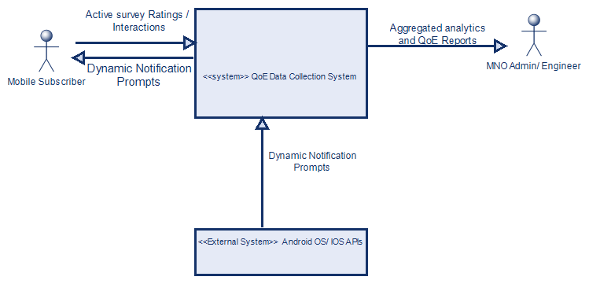

Slide 7

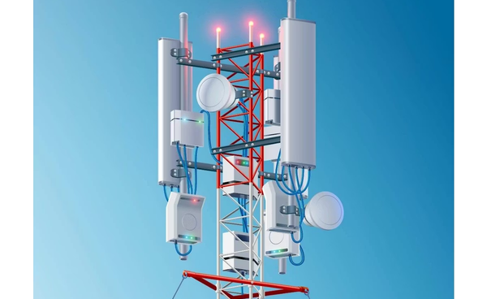
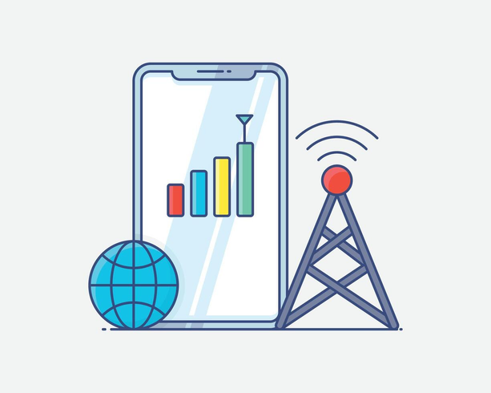
Users
Use Case Diagram
Actors and use cases mapped to system interactions
System interactions

Slide 8
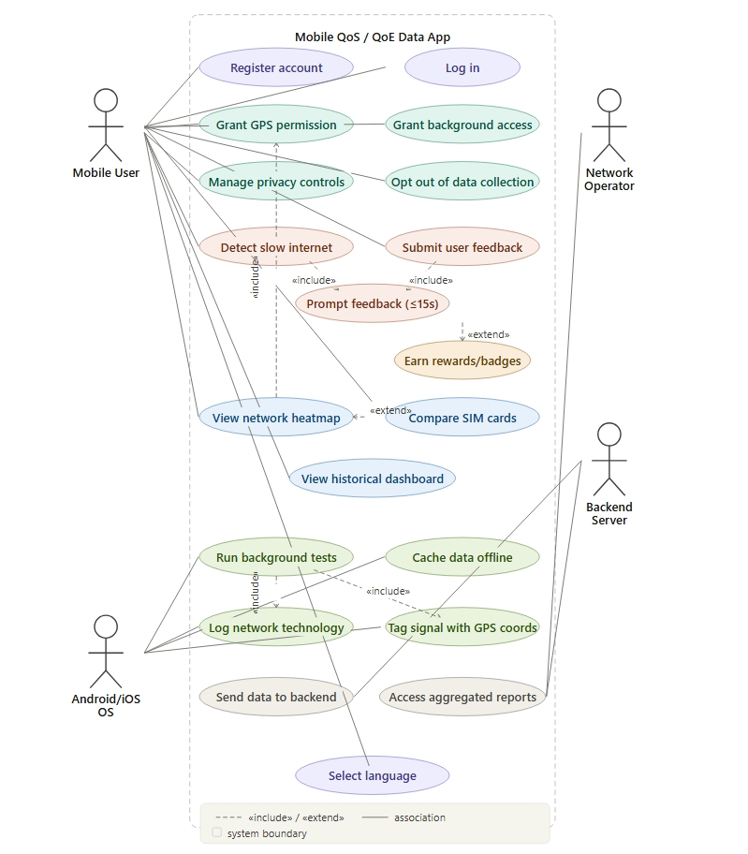

Slide 9


Scenario: Slow internet detected and user feedback collected
Sequence Diagram
This sequence diagram illustrates the complete flow when slow internet is detected. The Background Service monitors network conditions and triggers the App UI to prompt the user for feedback.
The user rates their network experience, which is then stored in the Local DB. The Sync Manager coordinates with the Cloud API to upload the anonymized data when connectivity permits, ensuring no feedback is lost.

Slide 10
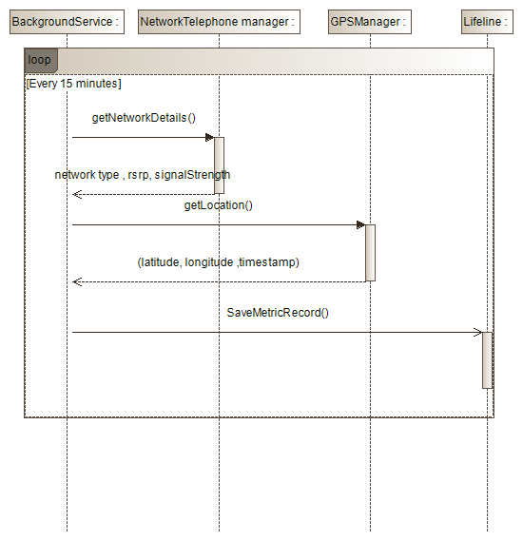
Scenario A: Passive Metric Collection and Transmission

Slide 11
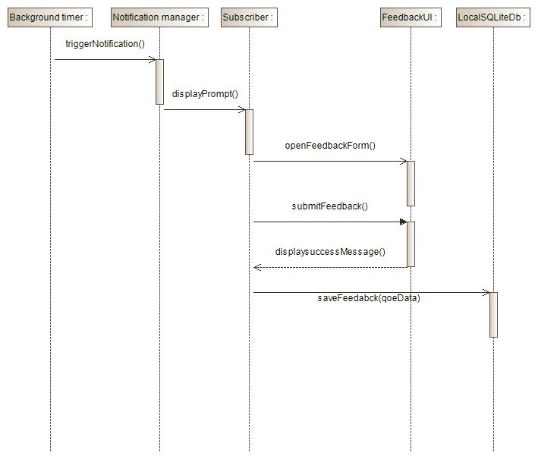
Scenario B: Active Feedback Collection

Slide 12
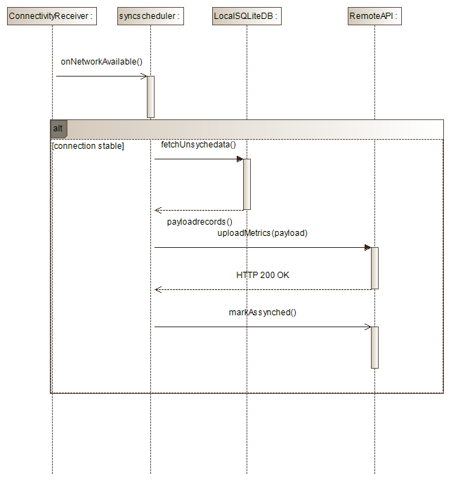
Data synchronization

Slide 13
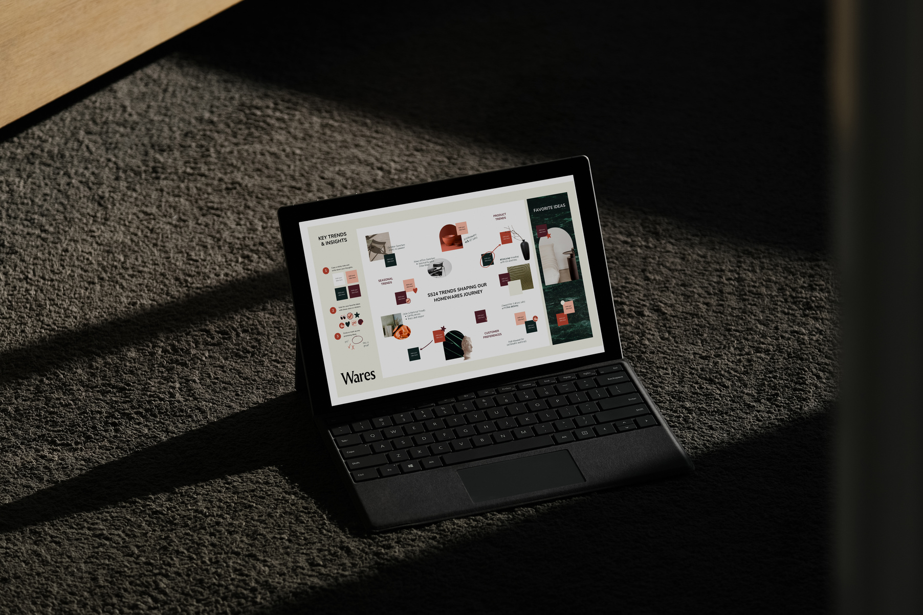
DFD Level 1
09 May, 2026
The Level 1 DFD illustrates the primary processes and data movements within the mobile app system. Key processes include the Data Collection Service gathering network metrics, the Trigger & Prompt Engine detecting quality issues, and User Feedback Capture recording ratings.
Data flows through Local Storage for offline caching, then to the Sync Manager which coordinates uploads. The Cloud Uploader transmits anonymized data to the backend, while Map & Reporting processes generate analytics outputs.
Data Flow Diagram

Slide 14
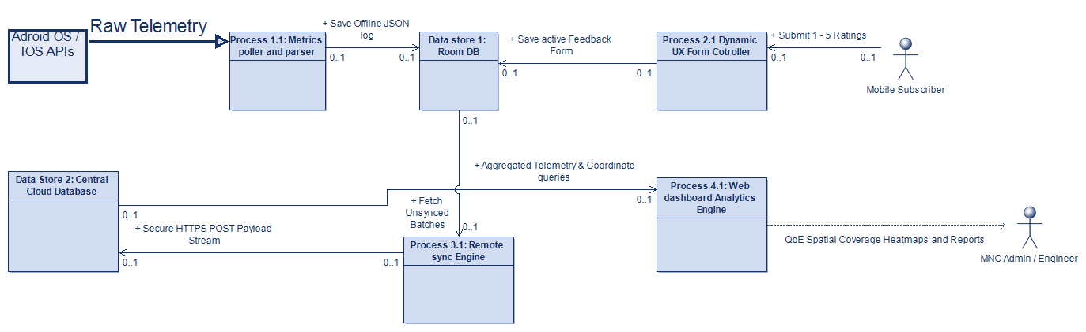

Slide 15
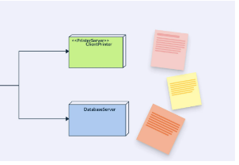
Class Diagram
09 May, 2026
Class Diagram
Key relationships include composition and aggregation patterns with defined multiplicities between users and use cases

Slide 16
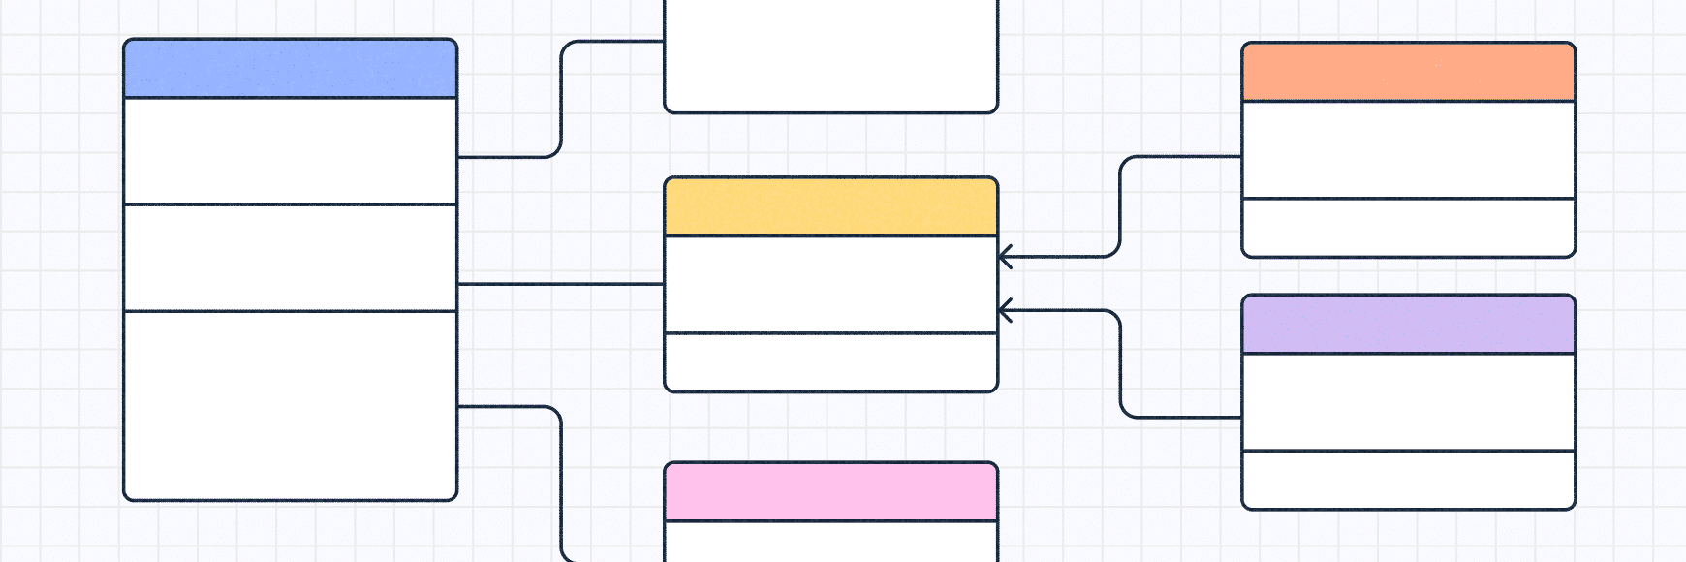
Class Diagram
The UML class diagram illustrates the core system architecture with the primary classes. UserSession manages authentication and session state, while NetworkFeedback and NetworkMetric capture user ratings and passive network measurements respectively.
LocationData handles GPS coordinates with privacy controls. DataCollectionService orchestrates background metric gathering, and SyncManager handles cloud synchronization with retry logic. RatingTriggerEngine determines when to prompt users for feedback based on network events.
Aggregated Tile and HeatMapRenderer work together for visualization, while FeedbackActivity provides the user interface for rating submissio

Slide 17
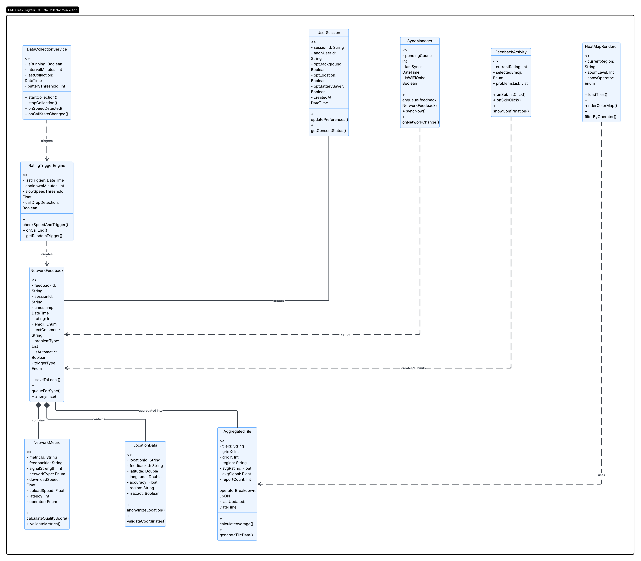

Slide 18
The system deployment architecture spans three distinct spaces. USER SPACE contains the Android mobile device running the data collection app with local SQLite database for offline storage. CLOUD SPACE hosts the backend infrastructure including AWS/GCP servers, API Gateway for secure communication, MongoDB and PostgresDB for centralized data storage, Redis cache for performance optimization, batch processor for data aggregation, and CloudFront CDN for content delivery.
ADMIN SPACE provides a web-based analytics dashboard enabling telecom researchers and administrators to monitor collected data, view heatmaps, and generate reports. Communication links connect all deployment nodes through secure HTTPS protocols.
Deployment Diagram
Three-tier architecture ensuring scalability and reliability

Slide 19
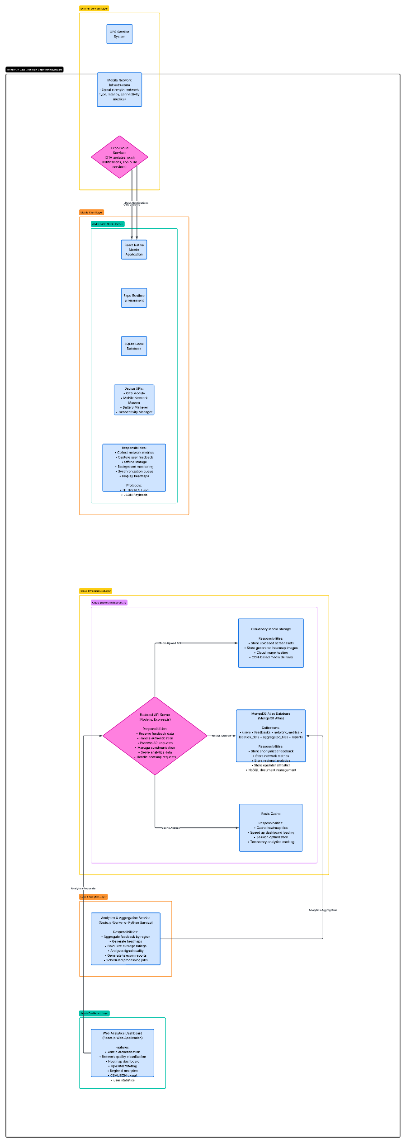

Slide 20

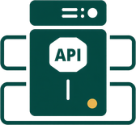

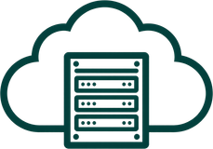
Technologies to be Used
Our mobile app leverages a modern, scalable technology stack designed for reliable data collection and seamless cloud synchronization. The architecture combines native Android development with robust backend services and enterprise-grade cloud infrastructure.
react native with Expo, Kotlin, Java for native mobile development
Node.js and Flask for RESTful API backend services
Cloudinary cloud storage, MongoDB and local caching
Railway Hosting, CloudFront CDN

Slide 21
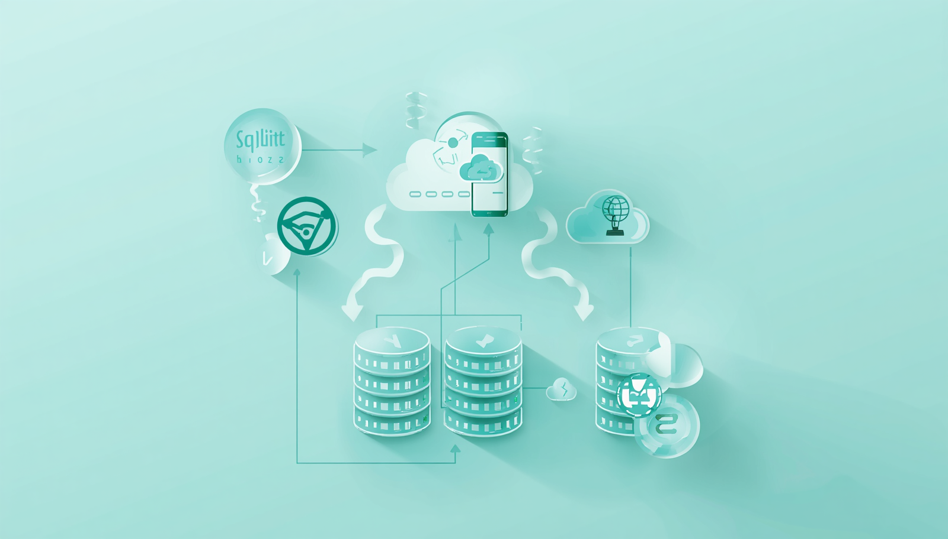
DATABASE & STORAGE DESIGN
1
2
Local Offline Queue
Cloud & Sync Strategy
Local database caches all collected metrics and user feedback locally on the device. Enables continuous data collection even without network connectivity. Implements queue-based architecture for pending uploads with automatic retry logic.
Data persists securely until successful cloud synchronization is confirmed. Lightweight footprint optimized for mobile device storage constraints.
MOngoDB serves as the centralized cloud database for all synchronized user experience data. Handles high-volume concurrent writes from thousands of mobile subscribers. Supports complex analytical queries for heatmap generation and reporting.
Sync strategy employs exponential backoff for intermittent connectivity. Data anonymization applied before upload using hashed user identifiers and location generalization techniques.

Slide 22




Privacy & Security
Protecting user data is fundamental to our system design. We implement multiple layers of security to ensure data confidentiality, integrity, and user privacy throughout the collection, transmission, and storage processes.
Anonymous user IDs protect identity
Permission-based GPS location access
Data encryption in transit and at rest
Secure API communication with HTTPS and tokens

Slide 23
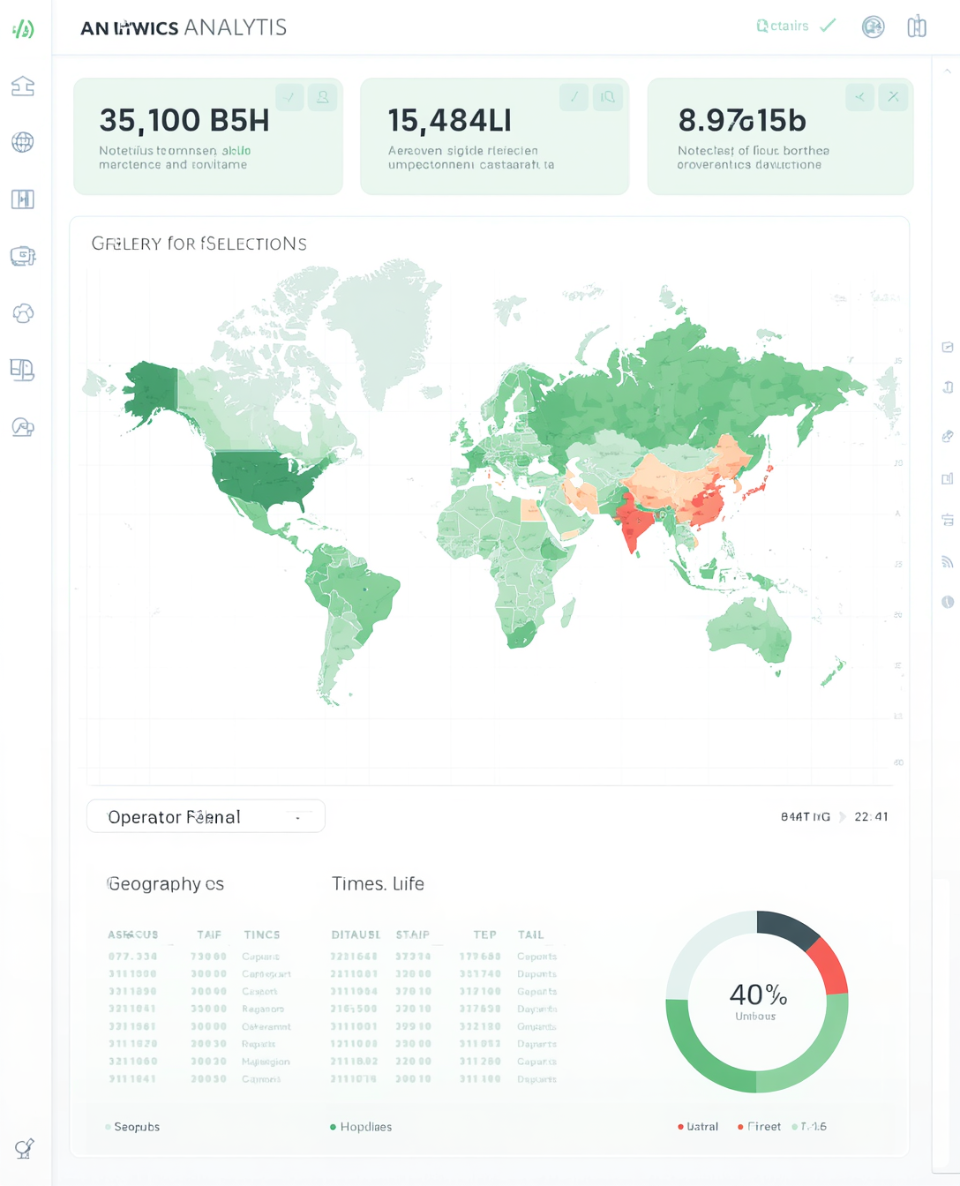
Heatmap & Analytics
The system aggregates network quality metrics into regional tiles for comprehensive visualization. Dynamic heatmaps display signal quality and user feedback across geographic areas, enabling identification of coverage patterns and problem zones.
Advanced filtering capabilities allow analysis by mobile operator and time period, supporting trend identification and comparative studies. The analytics dashboard presents color-coded maps and statistical summaries for actionable telecom insights.
Dynamic heatmaps visualize network quality through color-coded regional tiles

Slide 24




Benefits of the System
The mobile app system will deliver significant advantages for telecom operators, researchers, and network planners. By leveraging real user data and crowdsourced feedback, the platform enables data-driven decision making while maintaining robust data collection even in challenging connectivity conditions.
Improved telecom insights from real user data
Real-time Subscriber network feedback
Supports better network Statistics
Offline-first design ensures reliable data collection

Slide 25
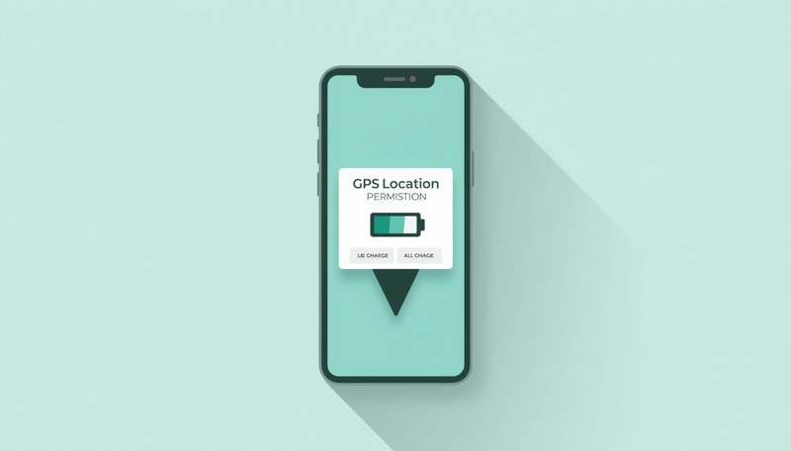
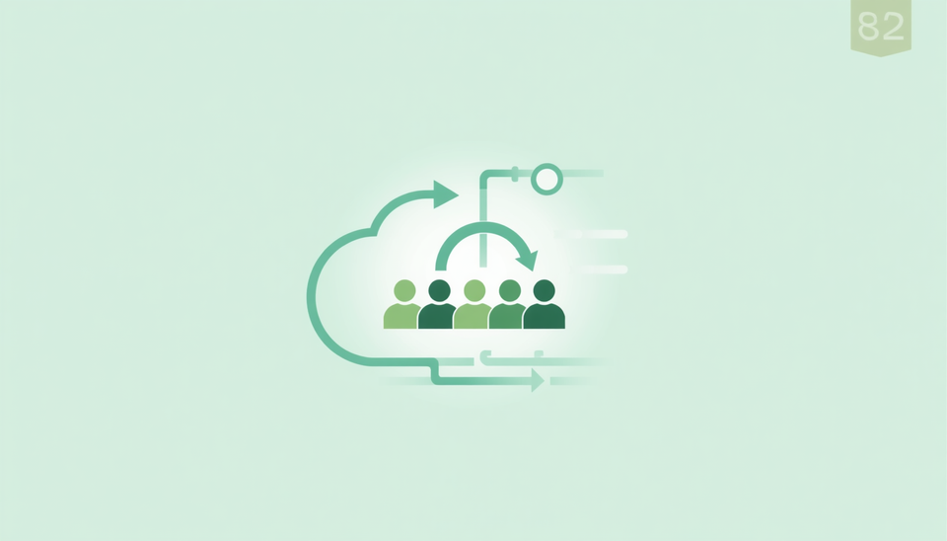
Challenges & Limitations
1
2
GPS Permissions & Battery Consumption
The app requires GPS permissions for location-based data collection, which some users may decline. Continuous background monitoring also increases battery consumption, requiring careful optimization to balance data quality with device performance.
Sync Delays & User Participation
Offline data synchronization introduces delays when connectivity is intermittent, potentially affecting real-time analytics. Additionally, variability in user participation and engagement impacts the volume and consistency of crowdsourced feedback data.

Slide 26
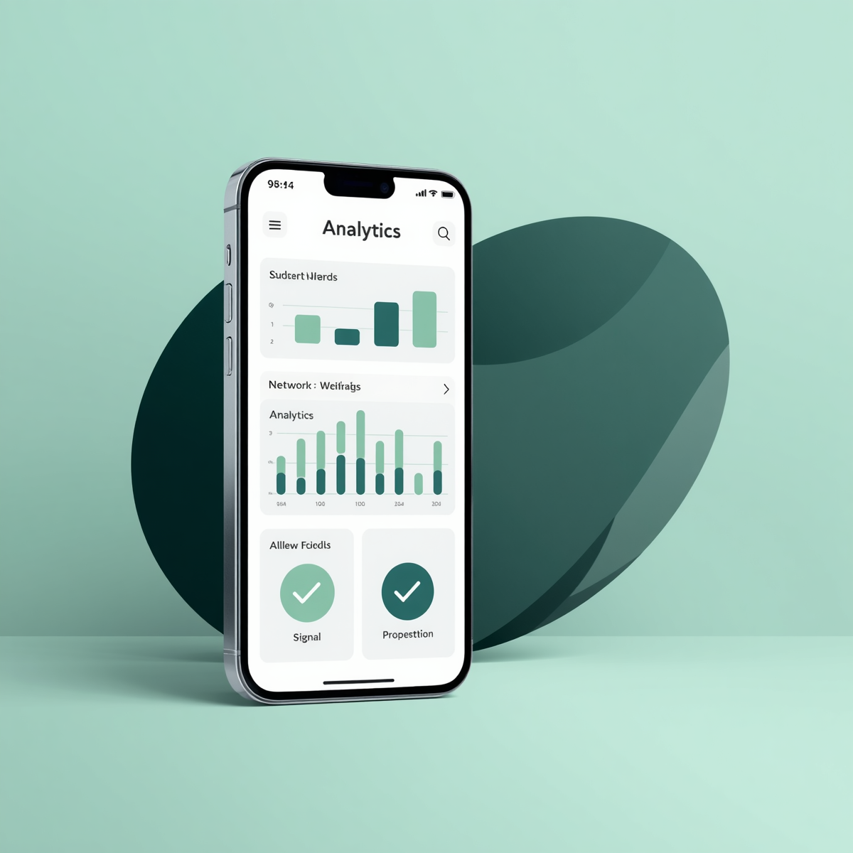
Thanks for your Atttendtion

Slide 27

Group 5 Presentation
25 May, 2026
Questions?
Ndefru Brayan
Akoh McPeace
Ngolien Lucy
Anelka

